Slide 1







CS 229br: Advanced Topics in the theory of machine learning
Boaz Barak
Ankur Moitra MIT 18.408
Yamini Bansal Official TF
Dimitris Kalimeris Unofficial TF
Gal Kaplun Unofficial TF
Preetum Nakkiran Unofficial TF
Join slack team and sign in on your devices!

Slide 2
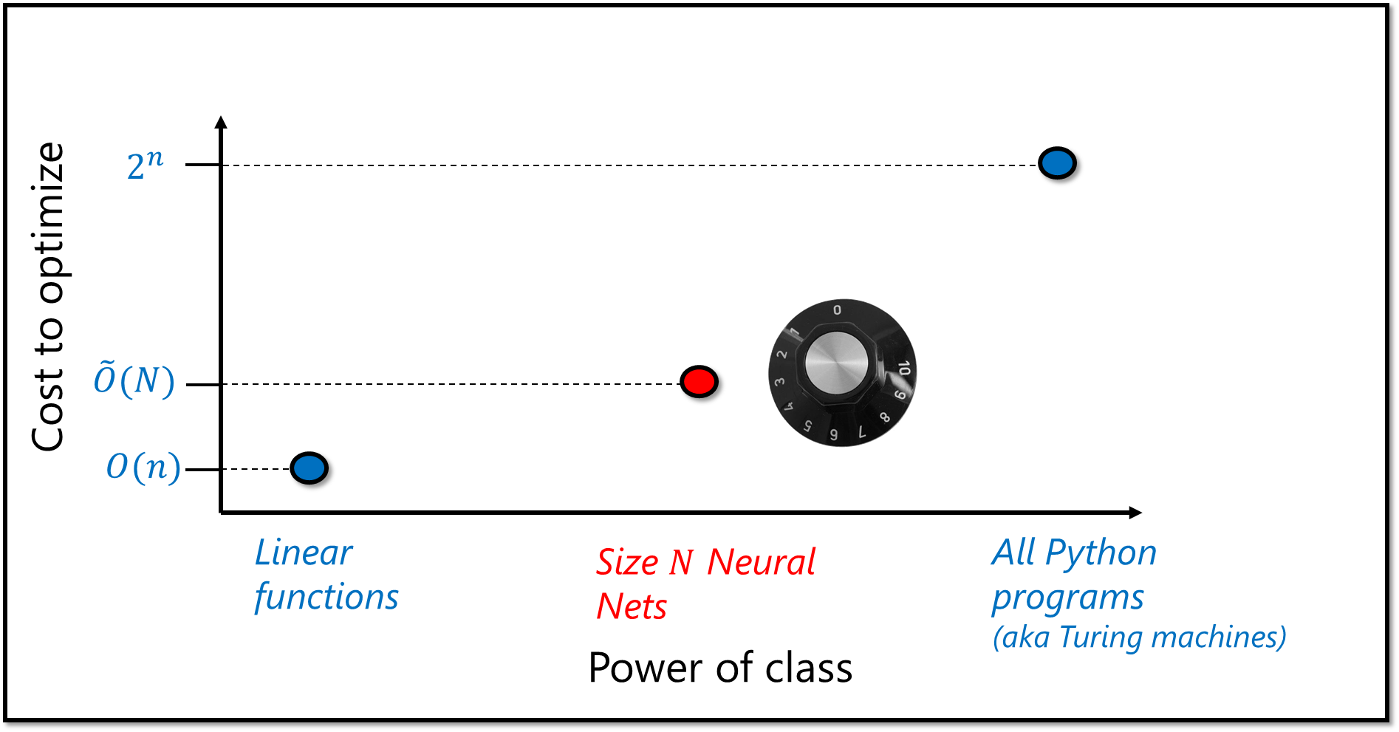





What is learning?
World
$$f$$
What is deep learning?

Slide 3











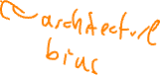
OOD, domain shift, robustness, fairness, ..
100
World
Benchmark
$$f$$
$$f$$
0
Generalization,..
Optimization,..
$$ℒ$$
OPT
$$f$$
$$ℒ$$
data
$$f$$
$$ℝ$$
data
$$ℱ$$

Slide 4
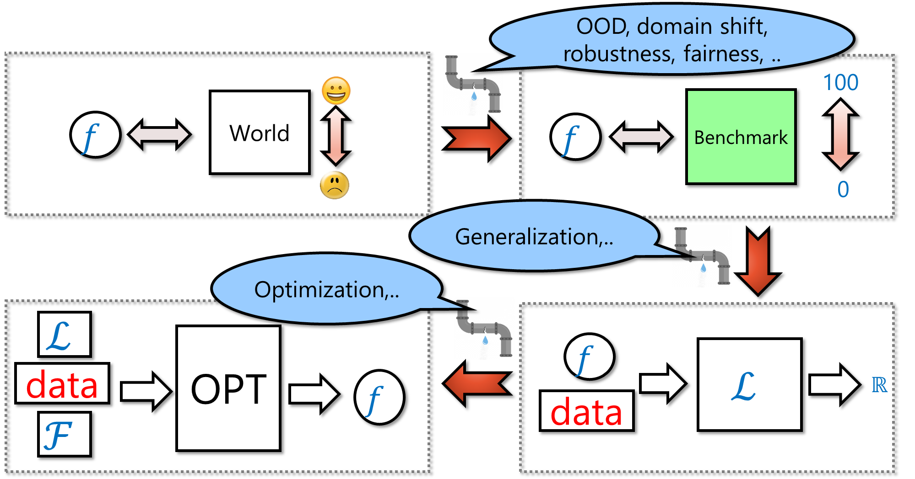

Slide 5


God’s view:
$$f={argmax}_{f}{𝔼\left[ (f) \right| data ]}$$
$$f={argmax}_{f}{𝔼[ (f↔w) ]}$$
$$w∼W|data$$
Perfect A
Perfect B
$$≠$$
Approx A
Approx B

Slide 6


This seminar
Taste of research results, questions, experiments, and more
Goal: Get to state of art research:
Background and language
Reading and reproducing papers
Trying out extensions
Very experimental and “rough around the edges”
A lot of learning on your own and from each other
Hope: Very interactive – in lectures and on slack
CS 229br: Survey of very recent research directions, emphasis on experiments
MIT 18.408: Deeper coverage of foundations, emphasis on theory

Slide 7
Student expectations
Not set in stone but will include:
Pre-reading before lectures
Scribe notes / blog posts (adding proofs and details)
Applied problem sets (replicating papers or mini versions thereof, exploring) Note: Lectures will not teach practical skills – rely on students to pick up using suggested tutorials, other resources, and each other. Unofficial TFs happy to answer questions!
Some theoretical problem sets.
Might have you grade each other’s work
Projects – self chosen and directed.
HW0 on slack
Grading: We’ll figure out some grade – hope that’s not your loss function ☺

Slide 8
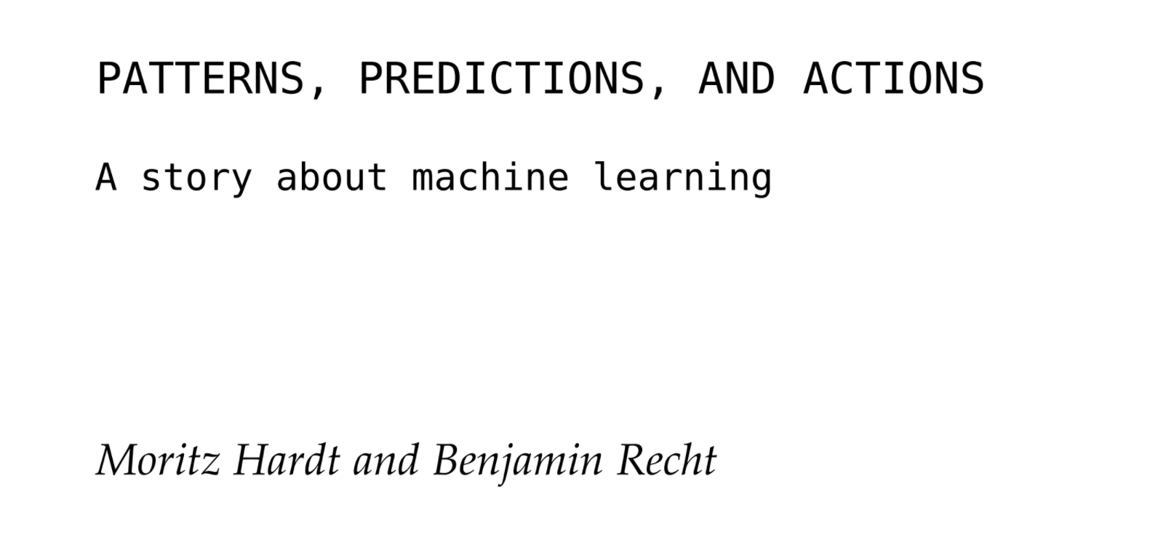
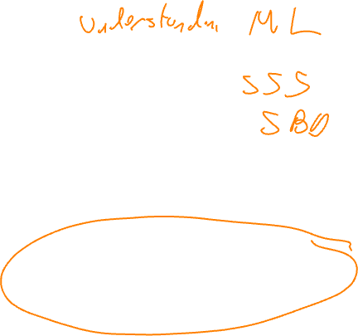
Rest of today’s lecture:
Blitz through classical learning theory
Special cases, mostly one dimension
“Proofs by picture”

Slide 9
Part I: Convexity & Optimization

Slide 10
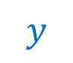

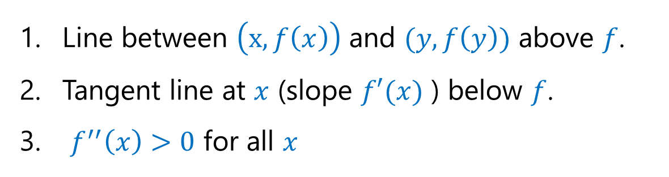


Convexity
Line between $\left(x,f\left(x\right)\right)$ and $(y,f\left(y\right))$ above $f$.
Tangent line at $x$ (slope $f′(x)$ ) below $f$.
$f^{′′}\left(x\right)>0$ for all $x$
$$f$$
$$x$$
$$y$$
CLAIM: $f^{′′}\left(x\right)<0$ implies tangent line at $x$ above $f$
Proof: $f\left(x+δ\right)=f\left(x\right)+δf^{′}\left(x\right)+δ^{2}f^{′′}\left(x\right)+O(δ^{3})$ implies $f$ below line

Slide 11

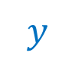

Convexity
Line between $\left(x,f\left(x\right)\right)$ and $(y,f\left(y\right))$ above $f$.
Tangent line at $x$ (slope $f′(x)$ ) below $f$.
$f^{′′}\left(x\right)>0$ for all $x$
$$f$$
$$x$$
$$y$$
CLAIM: If $f$ above $\left(x,f\left(x\right)\right)−(y,f\left(y\right))$ then exists $z$ with tangent line at $z$ above $f$
Proof by picture:
$$f$$
$$x$$
$$y$$

Slide 12
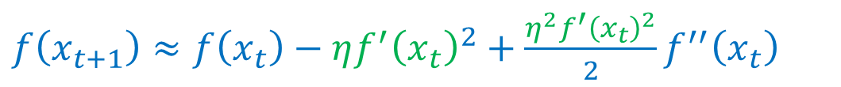
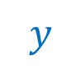
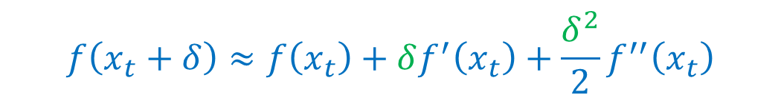
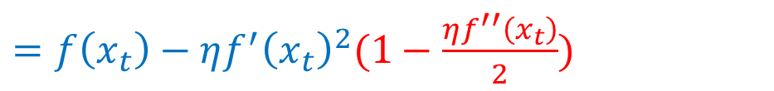
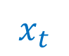

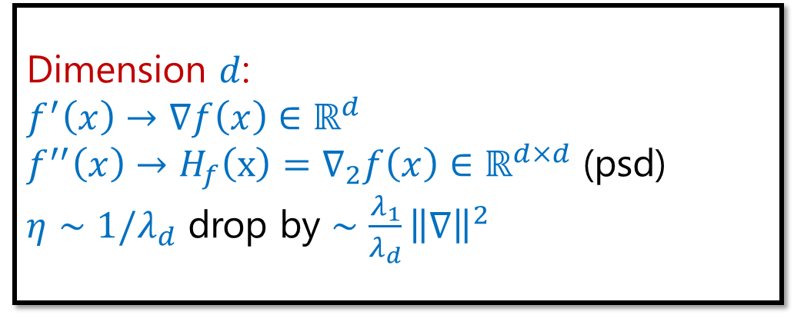
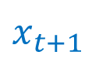


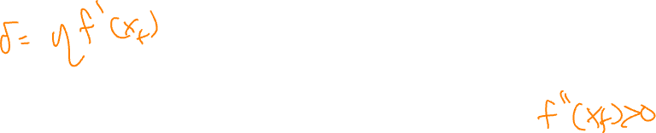
Gradient Descent
Dimension $d$: $f^{′}\left(x\right)→∇f\left(x\right)∈ℝ^{d}$
$f^{′′}\left(x\right)→{H_{f}\left(x\right)=∇}_{2}f\left(x\right)∈ℝ^{d×d}$ (psd)
$η∼1/λ_{d}$ drop by $∼\frac{λ_{1}}{λ_{d}}{\left\|∇\right\|}^{2}$
$$x_{t+1}=x_{t}−ηf′(x_{t})$$
$$f$$
$$x_{t}$$
$$x_{t+1}$$
$$y$$
$$f\left(x_{t}+δ\right)≈f\left(x_{t}\right)+δf^{′}\left(x_{t}\right)+\frac{δ^{2}}{2}f^{′′}\left(x_{t}\right)$$
$f\left(x_{t+1}\right)≈f\left(x_{t}\right)−ηf^{′}{\left(x_{t}\right)}^{2}+\frac{η^{2}f^{′}{\left(x_{t}\right)}^{2}}{2}f^{′′}\left(x_{t}\right)$
$=f\left(x_{t}\right)−ηf^{′}{\left(x_{t}\right)}^{2}(1−\frac{ηf^{′′}\left(x_{t}\right)}{2})$
If $η<2/f′′(x_{t})$ then make progress
If $η∼2/f′′(x_{t})$ then drop by $∼ηf^{′}{\left(x_{t}\right)}^{2}$

Slide 13
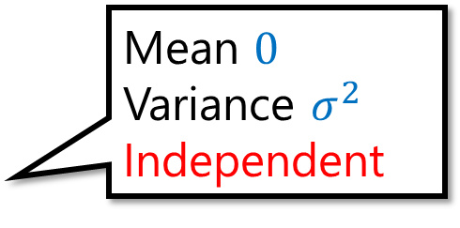
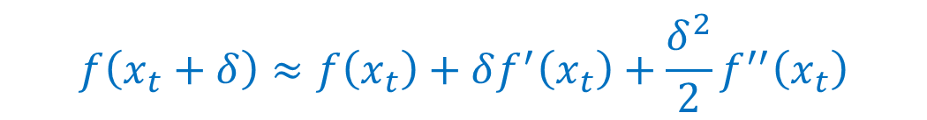

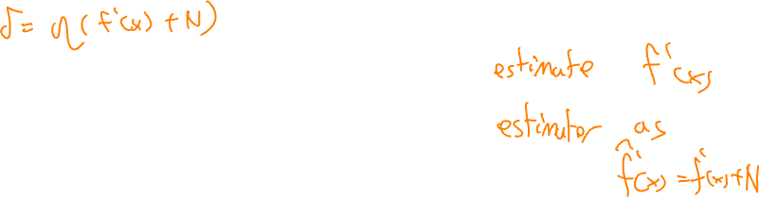


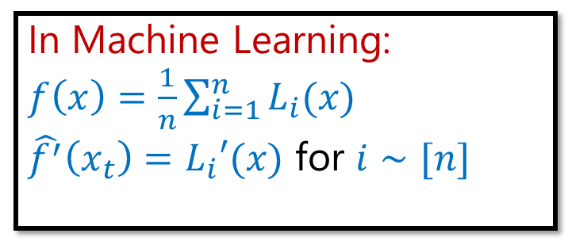
Stochastic Gradient Descent
In Machine Learning: $f\left(x\right)=\frac{1}{n}\sum_{i=1}^{n}{L_{i}(x)}$
$\hat{f^{′}}\left(x_{t}\right)=L_{i}′(x)$ for $i∼[n]$
$$x_{t+1}=x_{t}−η\hat{f′}(x_{t})$$
$𝔼\left[\hat{f^{′}}\left(x\right)\right]=f′(x_{t})$, $V\left[\hat{f^{′}}\left(x\right)\right]=σ^{2}$
Mean $0$ Variance $σ^{2}$ Independent
$$f$$
Assume $\hat{f^{′}}\left(x\right)=f^{′}\left(x\right)+N$
$$x_{t}$$
$$x_{t+1}$$
$$y$$
$$f\left(x_{t}+δ\right)≈f\left(x_{t}\right)+δf^{′}\left(x_{t}\right)+\frac{δ^{2}}{2}f^{′′}\left(x_{t}\right)$$
$f\left(x_{t+1}\right)≈f\left(x_{t}\right)−ηf^{′}{\left(x_{t}\right)}^{2}\left(1−\frac{ηf^{′′}\left(x_{t}\right)}{2}\right)+η^{2}σ^{2}f′′(x_{t})$
If $η<2/f′′(x_{t})$ and (*) $ησ^{2}≪f^{′}{\left(x_{t}\right)}^{2}/f′′(x)$ then make progress
If $η∼2/f′′(x_{t})$ and (*) then drop by $∼ηf^{′}{\left(x_{t}\right)}^{2}$

Slide 14
Part II: Generalization

Slide 15
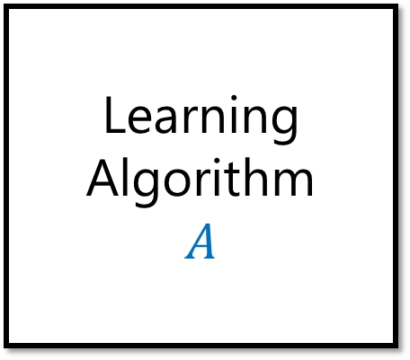
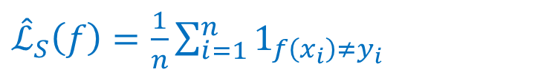




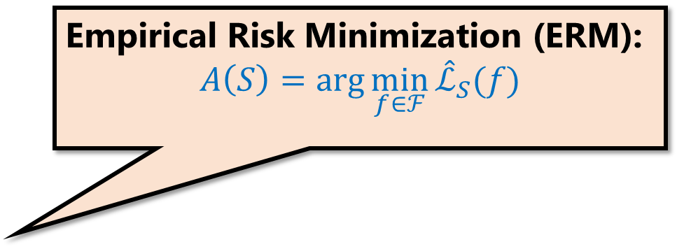
Supervised learning
Empirical Risk Minimization (ERM): $$A\left(S\right)=\arg{\min_{f∈ℱ}{{\hat{ℒ}}_{S}(f)}}$$
Distribution $(X,Y)$ over $𝒳×\{±1\}$
Learning Algorithm $$A$$
$S={\left(x_{i},y_{i}\right)}_{i=1..n}$
$$f∈ℱ$$
data
$$ℒ\left(f\right)=\operatorname{Pr}{[f\left(X\right)≠Y]}$$
${\hat{ℒ}}_{S}\left(f\right)=\frac{1}{n}\sum_{i=1}^{n}{1_{f\left(x_{i}\right)≠y_{i}} }$
Population 0-1 loss
Empirical 0-1 loss
Generalization gap: $ℒ\left(f\right)−{\hat{ℒ}}_{S}(f)$ for $f=A(S)$

Slide 16
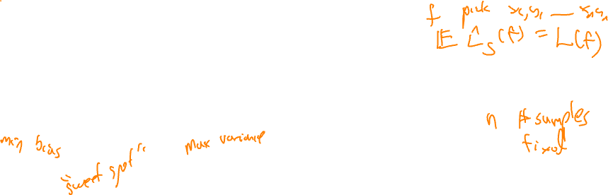

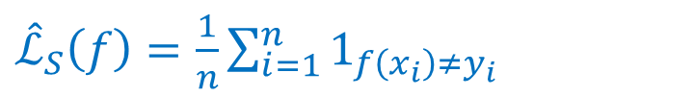
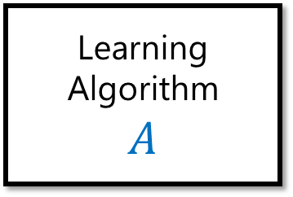

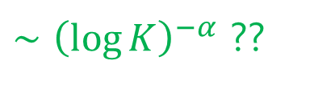

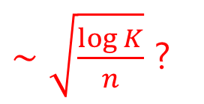

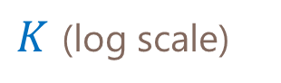
Bias Variance Tradeoff
Empirical Risk Minimization (ERM): $$A\left(S\right)=\arg{\min_{f∈ℱ}{{\hat{ℒ}}_{S}(f)}}$$
Learning Algorithm $$A$$
$$f∈ℱ$$
$S={\left(x_{i},y_{i}\right)}_{i=1..n}$
Population 0-1 loss
bias
${\hat{ℒ}}_{S}\left(f\right)=\frac{1}{n}\sum_{i=1}^{n}{1_{f\left(x_{i}\right)≠y_{i}} }$
$$ℒ\left(f\right)=\operatorname{Pr}{[f\left(X\right)≠Y]}$$
Empirical 0-1 loss
variance
Assume $ℱ_{K}=\{ f_{1},…, f_{K}\}$ , $\hat{ℒ}\left(f_{i}\right)=ℒ\left(f_{i}\right)+N(0, 1/n)$
$∼\sqrt{\frac{\log{K}}{n}}$ ?
Loss
$∼{\left(\log{K}\right)}^{−α}$ ??
$K$ (log scale)

Slide 17
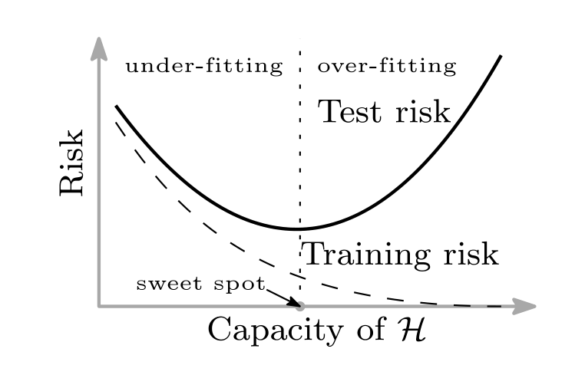

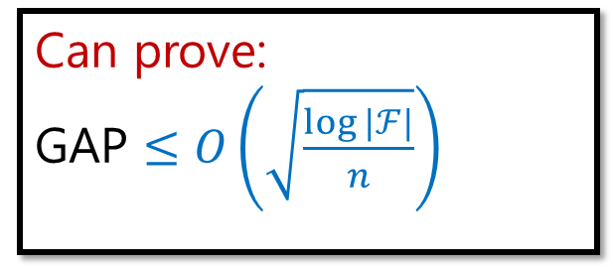
Bias Variance Tradeoff
Empirical Risk Minimization (ERM): $$A\left(S\right)=\arg{\min_{f∈ℱ}{{\hat{ℒ}}_{S}(f)}}$$
Learning Algorithm $$A$$
$$f∈ℱ$$
$S={\left(x_{i},y_{i}\right)}_{i=1..n}$
Population 0-1 loss
bias
$$ℒ\left(f\right)=\operatorname{Pr}{[f\left(X\right)≠Y]}$$
Empirical 0-1 loss
${\hat{ℒ}}_{S}\left(f\right)=\sum_{i=1}^{n}{1_{f\left(x_{i}\right)≠y_{i}} }$
variance
Assume $ℱ_{K}=\{ f_{1},…, f_{K}\}$ , $\hat{ℒ}\left(f_{i}\right)=ℒ\left(f_{i}\right)+N(0, 1/n)$
Can prove: GAP $≤$ $O\left(\sqrt{\frac{\log{|ℱ|}}{n}}\right)$
$∼\sqrt{\frac{\log{K}}{n}}$ ?
Loss
$∼{\left(\log{K}\right)}^{−α}$ ??
$K$ (log scale)

Slide 18


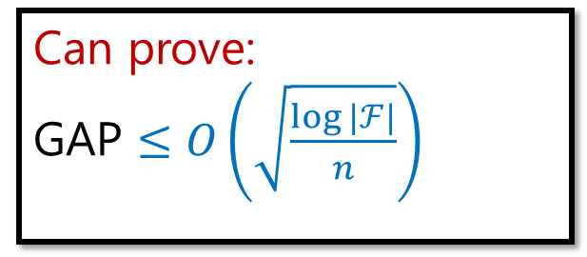
Population 0-1 loss
$$ℒ\left(f\right)=\operatorname{Pr}{[f\left(X\right)≠Y]}$$
Empirical 0-1 loss
${\hat{ℒ}}_{S}\left(f\right)=\sum_{i=1}^{n}{1_{f\left(x_{i}\right)≠y_{i}} }$
Can prove: GAP $≤$ $O\left(\sqrt{\frac{\log{|ℱ|}}{n}}\right)$
THM: with high prob over $S∼{\left(X,Y\right)}^{n}$, $\max_{f∈ℱ}\left|ℒ\left(f\right)−{\hat{ℒ}}_{S}(f) \right|≤O\left(\sqrt{\frac{\log\left|ℱ\right|}{n}}\right)$

Slide 19

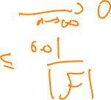




Population 0-1 loss
$$ℒ\left(f\right)=\operatorname{Pr}{[f\left(X\right)≠Y]}$$
Empirical 0-1 loss
${\hat{ℒ}}_{S}\left(f\right)=\sum_{i=1}^{n}{1_{f\left(x_{i}\right)≠y_{i}} }$
THM: with high prob over $S∼{\left(X,Y\right)}^{n}$, $\max_{f∈ℱ}\left|ℒ\left(f\right)−{\hat{ℒ}}_{S}(f) \right|≤O\left(\sqrt{\frac{\log\left|ℱ\right|}{n}}\right)$
LEM: For every fixed $f$, $\underset{S}{Pr}\left[\left|ℒ\left(f\right)−{\hat{ℒ}}_{S}(f) \right|≥\frac{k}{\sqrt{n}}\right]≤exp⁡(−c⋅k^{2})$
PF: Central limit thm / Chernoff / Hoeffding / ….
$$σ∼1/\sqrt{n}$$
$$\operatorname{Pr}\left[\left|X−𝔼X\right|≥kσ\right]≤\exp{(−c⋅k^{2})}$$
$$ℒ\left(f\right)−kσ$$
$$ℒ(f)$$
$$ℒ\left(f\right)+kσ$$
LEM$⇒$THM: Set $k=10⋅\sqrt{\log\left|ℱ\right|}/c$

Slide 20



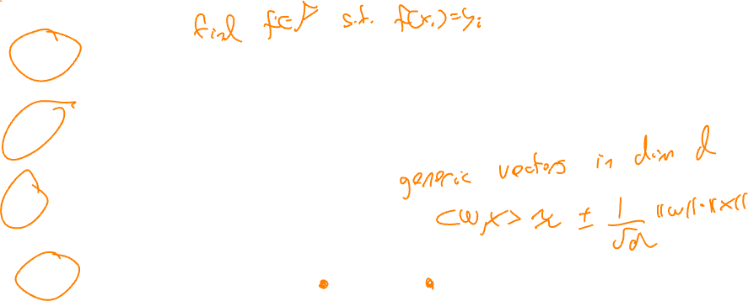
Generalization bounds
Can prove: GAP $≤$ $O\left(\sqrt{\frac{\log{|ℱ|}}{n}}\right)$
$\log{|ℱ|}$ can be replaced with dimensionality / capacity of $ℱ$
VC dimension: $\max{d}$ s.t. $ℱ$ can fit every labels $y∈{\left\{±1\right\}}^{d}$ on every samples $x_{1},…,x_{d}$
Rademacher complexity: $\max{d}$ s.t. $ℱ$ can fit random labels $y∼{\left\{±1\right\}}^{d}$ on random $x_{1},…,x_{d}∼X$
PAC Bayes: $d=I(A\left(S\right);S)$ where $S$ is training set.
Margin bounds: $\max{d}$ s.t. linear classifier satisfies $\left\langle w_{i},x_{i}\right\rangle y_{i}>\left\|w_{i}\right\|⋅\left\|x_{i}\right\|/\sqrt{d}$ for correct predictions

Slide 21
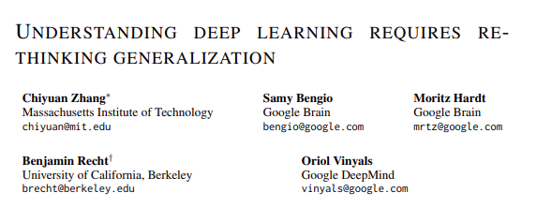
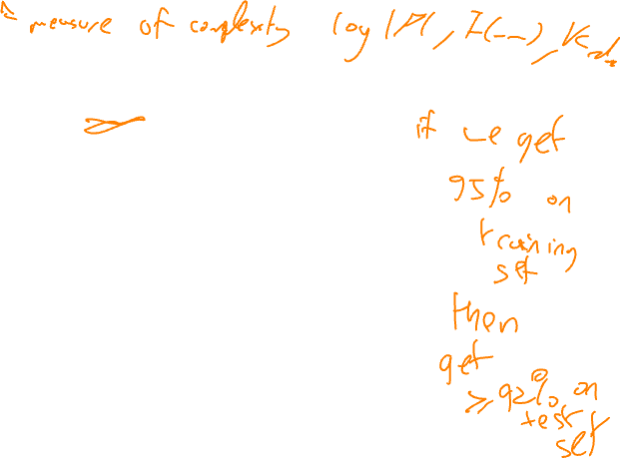
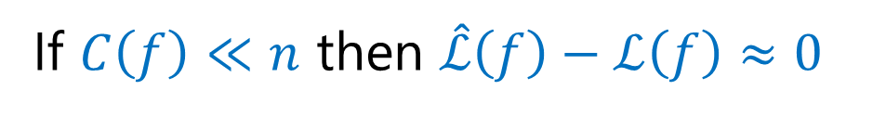

General form:
If $C\left(f\right)≪n$ then $\hat{ℒ}\left(f\right)−ℒ\left(f\right)≈0$
Intuition: Can’t “overfit” – if you do well on $n$ samples, must do well on population
Challenge: Many modern deep nets and natural $C$ , $C\left(f\right)≫n$
Hope: Find better $C$?
ICLR 2017

Slide 22
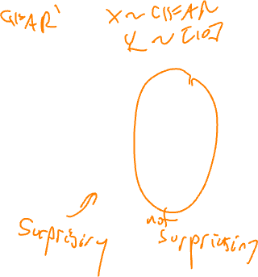
General form:
If $C\left(f\right)≪n$ then $\hat{ℒ}\left(f\right)−ℒ\left(f\right)≈0$
Intuition: Can’t “overfit” – if you do well on $n$ samples, must do well on population
Challenge: Many modern deep nets and natural $C$ , $C\left(f\right)≫n$
Hope: Find better $C$?
Performance on CIFAR-10
Performance on noisy CIFAR-10:*
Classifier | Train | Test
Wide ResNet¹ | 100% | 92%
ResNet 18² | 100% | 87%
Myrtle³ | 100% | 86%
Train | Test
100% | 10%
100% | 10%
100% | 10%
¹ Zagoruyko-Komodakis’16 ² He-Zhang-Ren-Sun’15 ³ Page ’19

Slide 23
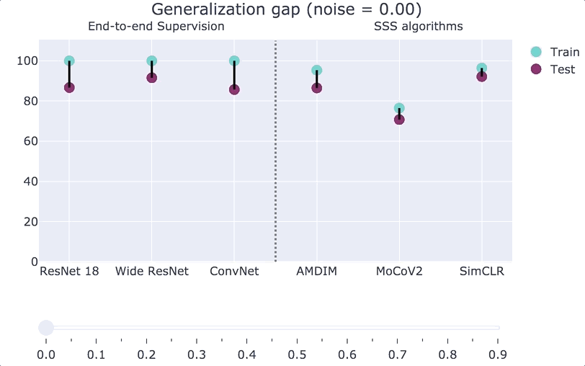

Bansal-Kaplun-B, ICLR 2021

Slide 24
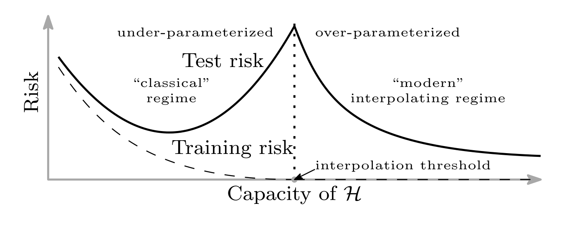
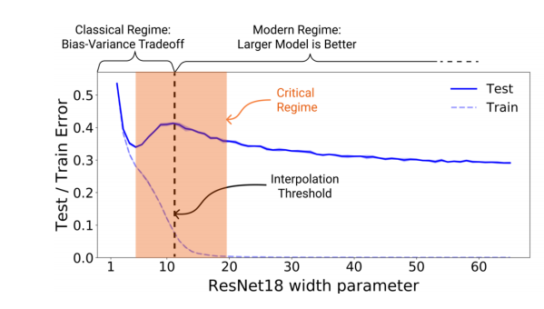
“Double descent”
Belkin, Hsu, Ma, Mandal, PNAS 2019.
Nakkiran-Kaplun-Bansal-Yang-B-Sutskever, ICLR 2020

Slide 25



Example:
Data: $(x_{i},f^{∗}\left(x_{i}\right)+N)$ where $f^{∗}$ degree $d^{∗}$ polynomial
Algorithm: SGD to minimize $∑{\left(f\left(x_{i}\right)−y_{i}\right)}^{2}$ where $f∈ℱ_{d}$=degree $d$ polys
Cartoon:
Test
Train
Loss/error
$$d^{∗}$$
$$n$$
degree $d$ = $C(ℱ)$

Slide 26
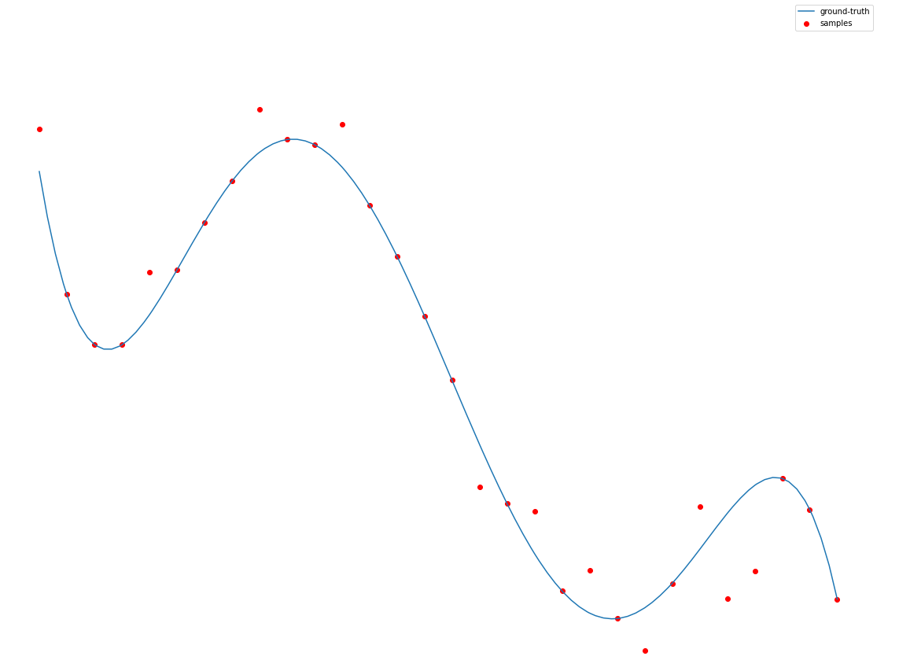
Example:
Data: $(x_{i},f^{∗}\left(x_{i}\right)+N)$ where $f^{∗}$ degree $d^{∗}$ polynomial
Algorithm: SGD to minimize $∑{\left(f\left(x_{i}\right)−y_{i}\right)}^{2}$ where $f∈ℱ_{d}$=degree $d$ polys

Slide 27
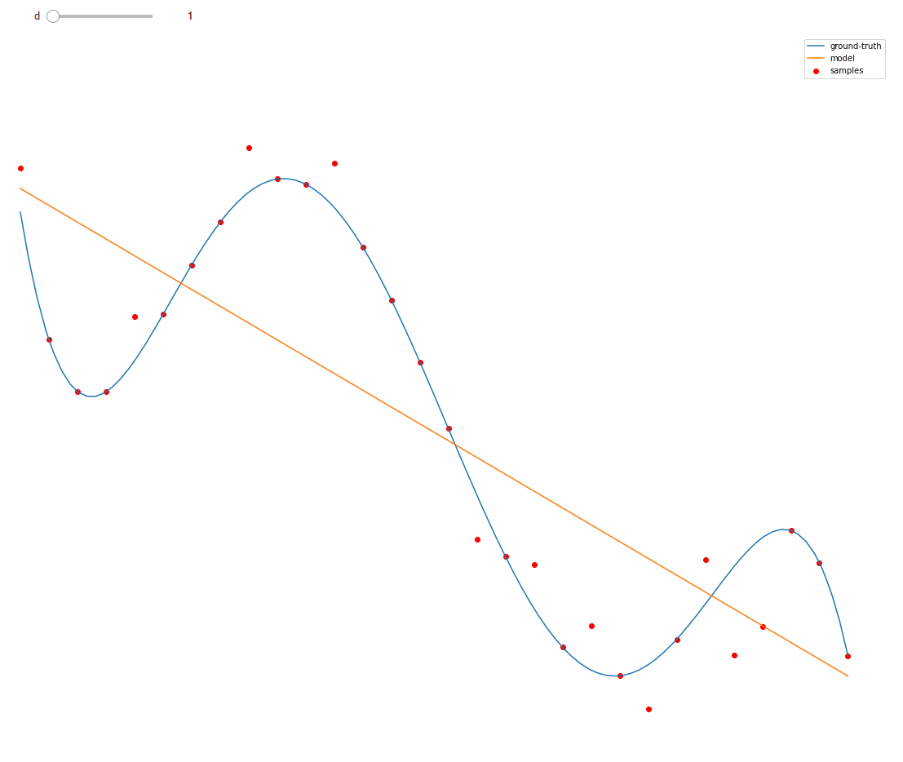
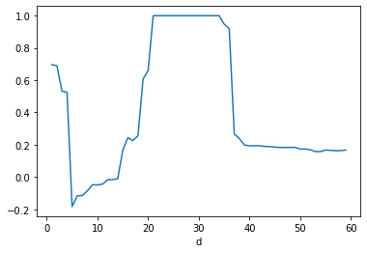
Example:
Data: $(x_{i},f^{∗}\left(x_{i}\right)+N)$ where $f^{∗}$ degree $d^{∗}$ polynomial
Algorithm: SGD to minimize $∑{\left(f\left(x_{i}\right)−y_{i}\right)}^{2}$ where $f∈ℱ_{d}$=degree $d$ polys

Slide 28
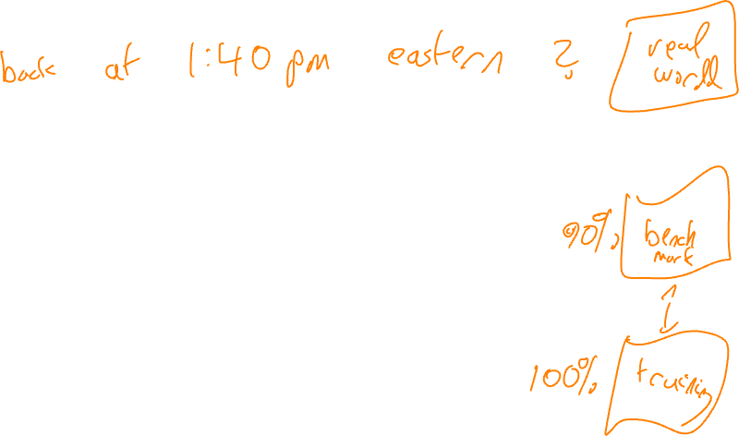
Part III: Approximation and Representation

Slide 29


Example:
Hello
Hello

Slide 30
Example:
After Fourier Transform
Linear classifier
Hello
Hello

Slide 31
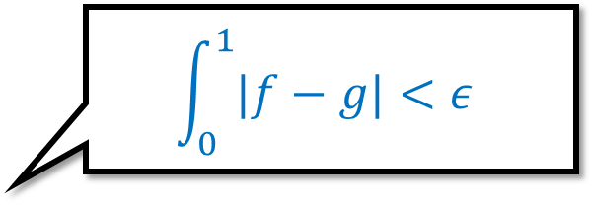



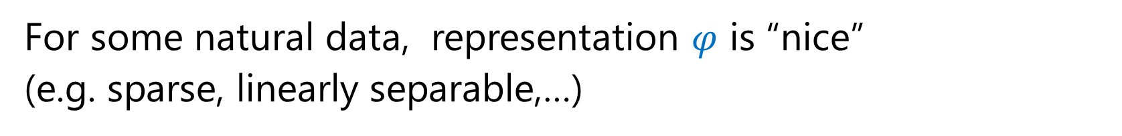
Fourier Transform
$$\int_{0}^{1}{|f−g|}<ε$$
Every continuous $f:\left[0,1\right]→ℝ$ can be arbitrarily approximated by $g$ of form
$$g\left(x\right)=∑α_{j}e^{−2πi β_{j}x}$$
i.e., $f$ $≈$ linear in $φ_{1}\left(x\right),…,φ_{N}(x)$ where $φ_{j}\left(x\right)=e^{−2πi β_{j}x}$
$φ:ℝ→ℝ^{N}$ embedding
For some natural data, representation $φ$ is “nice” (e.g. sparse, linearly separable,…)
Tasks become simpler after transformation $x→φ(x)$

Slide 32
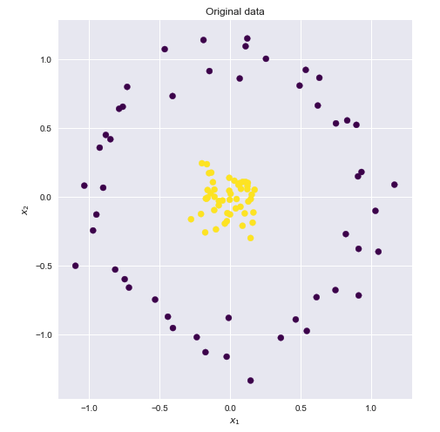
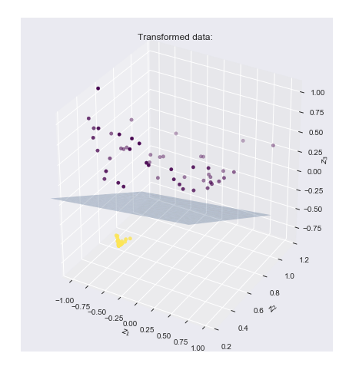

$$φ\left(x,y\right)=(xy,x^{2},y^{2})$$
Xavier Bourret Sicotte, https://xavierbourretsicotte.github.io/Kernel_feature_map.html

Slide 33
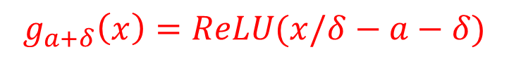














More approximation
$$ReLU\left(x\right)=\max{(x,0)}$$
Every continuous $f:\left[0,1\right]→ℝ$ can be arbitrarily approximated by $g$ of form
$$g(x) =∑α_{i} ReLU(β_{i}x+γ_{i})$$
Proof by picture:
$$g_{a}\left(x\right)=ReLU(x/δ−a)$$
$$h_{a}=g_{a}−g_{a+δ}$$
$$I_{a,b}=h_{a}−h_{b}$$
$$g_{a+δ}\left(x\right)=ReLU(x/δ−a−δ)$$
$$1$$
$$0$$
$$a$$
$$a+δ$$
$$a$$
$$a+δ$$
$$a$$
$$b$$

Slide 34



More approximation
$$ReLU\left(x\right)=\max{(x,0)}$$
Every continuous $f:\left[0,1\right]→ℝ$ can be arbitrarily approximated by $g$ of form
$$g(x) =∑α_{i} ReLU(β_{i}x+γ_{i})$$
Proof by picture:
$$I_{a,b}=h_{a}−h_{b}$$
$$f$$
$$g$$

Slide 35



Higher dimension
$r\left(x\right)=\max{(\left\langle α,x\right\rangle +β,0)}$ , $d+1$ parameters
$$I(x)$$
$$J_{\left(1,0\right)}\left(x,y\right)=I\left(x\right)$$

Slide 36
Higher dimension
$r\left(x\right)=\max{(\left\langle α,x\right\rangle +β,0)}$ , $d+1$ parameters
$$I(x)$$
$$J_{\left(1,0\right)}\left(x,y\right)=I\left(x\right)$$

Slide 37
Higher dimension
$r\left(x\right)=\max{(\left\langle α,x\right\rangle +β,0)}$ , $d+1$ parameters
$$I(x)$$

Slide 38








How many ReLU’s
Every $f:{[0,1]}^{d}→ℝ$ can be approximated as sum of $r_{α,β}\left(x\right)=\max{(\left\langle α,x\right\rangle +β)}$
Can discretize $ℝ^{d+1}$ to $O{\left(1\right)}^{d}$ points – need at most $O{\left(1\right)}^{d}=2^{O\left(d\right)}$ ReLUs
(For formal proofs, see Cybenko ‘89, Hornik ‘91, Barron ’93; MIT 18.408)
THM: For some $f$’s , $2^{c⋅d}$ ReLU’s are necessary
Random $f:{\left[0,1\right]}^{d}→ℝ$
Choose $f\left(x\right)∈\{0,1\}$ independently at random for $x∈{\left\{1/4, 3/4 \right\}}^{d}$
$$1$$
$$1$$
Extend linearly
$$1/2$$
$$1/2$$
$$0$$
LEMMA: For every fixed $g:{\left[0,1\right]}^{d}→ℝ$, $\operatorname{Pr}\left[ ∫\left|f−g\right|<0.1 \right]≤2^{−ε⋅2^{d}}$

Slide 39










THM: For some $f$’s , $2^{c⋅d}$ ReLU’s are necessary
Random $f:{\left[0,1\right]}^{d}→ℝ$
$$1$$
$$1$$
Choose $f\left(x\right)∈\{0,1\}$ independently at random for $x∈{\left\{1/4, 3/4 \right\}}^{d}$
$$1/2$$
$$1/2$$
Extend linearly
$$0$$
LEMMA: For every fixed $g:{\left[0,1\right]}^{d}→ℝ$, $\operatorname{Pr}\left[ ∫\left|f−g\right|<0.1 \right]≤2^{−ε⋅2^{d}}$
LEMMA $⇒$ THEORM: Need $2^{ε⋅2^{d}}$ distinct $g$’s $⇒$ need $≈2^{d}$ distinct ReLUs
PROOF OF LEMMA: For $x∈{\left\{1/4,3/4\right\}}^{d}$ let $Z_{x}=1$ iff $∫\left|g\left(y\right)−f\left(y\right)\right|dy>0.2$ over $y∈{\left[−1/4,+1/4\right]}^{d}+x$
Each $Z_{x}$ is independent with expectation at least $1/2$
$$⇒\operatorname{Pr}{[\frac{1}{2^{d}}∑Z_{x}}<1/4 ]≤2^{−0.1⋅2^{d}}$$
$$\frac{1}{2^{d}}∑Z_{x}≥1/4 ⇒∫\left|g−f\right|≥1/20$$

Slide 40




Bottom line
For every* function $f:ℝ^{d}→ℝ$ many choices of $φ:ℝ^{d}→ℝ^{N}$ s.t. $$f≈Linear_{f}∘φ$$
Want to find $φ$ that is useful for many interesting functions $f$
Or $f$’s such that $ψ∘f$ interesting for some non-linear $ψ:ℝ→ℝ$
useful:
$N$ is not too big
Efficiently compute $φ(x)$ or $⟨φ\left(x\right), φ\left(y\right)⟩$
$⟨φ\left(x\right),φ\left(y\right)⟩$ large $⇔$ $x$ and $y$ are “semantically similar”
For interesting $f$’s, coefficients of $Linear_{f}$ are structured.
…

Slide 41
Part IV: Kernels

Slide 42














Neural Net
Kernel
$$x$$
$$φ$$
$$L$$
$$x$$
$$φ$$
$$L$$
Definitely NN
Definitely Kernel
$φ$ trained end-to-end for task at hand
$φ$ pretrained with same data
$φ$ pretrained on different data
$φ$ pretrained on synthetic data
$φ$ hand-crafted based on neural architectures
$φ$ hand-crafted before 1990s

Slide 43


Kernel methods (intuitively)
Distance measure $K\left(x,x^{′}\right)$
Input: $\left(x_{1},y_{1}\right),…, (x_{n},y_{n})$ s.t. $f^{∗}\left(x_{i}\right)≈y_{i}$
To approx $f^{∗}\left(x\right)$ output $y_{i}$ for $x_{i}$ closest to $x$
or output $∑α_{i}y_{i}$ with $α_{i}$ depending on $K(x,x_{i})$

Slide 44



Hilbert Space
Linear space: $v+u$, $c⋅v$
Dot product: $\left\langle u,v+c⋅w\right\rangle =\left\langle u,v\right\rangle +c\left\langle u,w\right\rangle , \left\langle u,v\right\rangle =\left\langle v,u\right\rangle , \left\langle v,v\right\rangle ≥0$
Can solve linear equations of form $\{ \left\langle v_{i},x\right\rangle =b_{i} \}$ knowing only $⟨v_{i},v_{j}⟩$
Also do least-square minimization $\min_{x}{∑(\left\langle v_{i},x\right\rangle −b_{i})^2}$ knowing only $⟨v_{i},v_{j}⟩$
DEF: Sym matrix $K∈ℝ^{n×n}$ is p.s.d. if $v^{T}Kv≥0$ for all $v∈ℝ^{n}$
Equivalently $λ_{1}\left(K\right),…, λ_{n}\left(K\right)≥0$
CLAIM: $K$ is p.s.d. iff* $u^{T}Kv$ is inner product
PROOF $(⇒)$: $u^{T}Kv=ψ\left(u\right)⋅ψ(v)$ where $ψ\left(u_{1},…,u_{n}\right)=(\sqrt{λ_{1}}u_{1}, …, \sqrt{λ_{n}}u_{n})$ , expressed in eigenbasis

Slide 45


Kernel Methods
Goal: Solve linear equations, least-square minimization, etc. under $φ$
Observation: Enough to compute $K\left(x,x′\right)=⟨φ\left(x\right),φ\left(x′\right)⟩$
Let $\hat{x}=φ(x)$, given ${\left\{{\hat{x}}_{i},y_{i}\right\}}_{i=1..n}$ want to find $\hat{w}∈ℝ^{n}$ s.t. $\left\langle {\hat{x}}_{i}, \hat{w}\right\rangle ≈y_{i}$ $∀i$
can compute $\hat{w}=∑α_{i} {\hat{x}}_{i}$ using $K(x_{i},x_{j})$
To compute prediction on new $x$ using $\hat{w}$, can compute $\hat{x}=∑β_{i} {\hat{x}}_{i}$ using $K(x,x_{i})$

Slide 46


